Slide 1

AI Interview Coach
An Interactive UI/UX Prototype for AI-Driven Interview Preparation, System Architecture & Analytics
SUBJECT : DBS & DB | COURSE CODE : 25CS1302E | FACULTY : DR. KHAJA SHAREEF
REVIEW 1

Slide 2
SI NO | NAME | ROLL NO
1 | K.PAVAN KUMAR | 2520090038
2 | P.HARSHA VARDHAN | 2520090180
3 | B.PURNA CHANDAR RAO | 2520090188

Slide 3


Rejection vs AI Practice Impact
Why Candidates Fail
Impact of AI Practice
• 68% of candidates fail initial rounds not due to technical knowledge, but due to unstructured answers, poor pacing, and speech fillers.
• 2x Higher Offer Rate: Candidates completing 5+ realistic mock sessions convert callbacks to offers at double the rate of unguided candidates.
• 73% of job seekers experience severe anxiety without realistic practice, leading to low confidence under live pressure.
• +15% Confidence Boost: AI-driven feedback improves speech clarity and reduces live anxiety responses measurably.

Slide 4






Problem Statement & AI Solution
Interview Anxiety
Inaccessible Coaching
AI Practice Coach
Candidates face intense anxiety due to a lack of realistic, timed practice opportunities before real placement drives.
Human 1-on-1 interview coaches are expensive, hard to schedule, and lack objective data-driven performance metrics.
Provides 24/7 accessible mock simulations with instant analysis on grammar, fluency, and technical competence.

Slide 5



Project Structure & Architecture
Frontend Views
Styling System
Client Engine
• — Hero Landing
• — Analytics Hub
• — Simulator
• — AI Report
• — Achievements
• Unified Glassmorphism styling
• Custom CSS variables for light/dark mode engine
• Bootstrap 5 Grid for fluid responsiveness
• Smooth CSS keyframe animations & progress rings
• Modular vanilla JavaScript
• Handles state, countdown timers, and forms
• Animated counter & circular progress rendering
• Voice recording UI simulation & navigation

Slide 6




Project Workflow Pipeline
2. Mock Setup
4. AI Evaluation
Selects HR Behavioral or Technical track; system initializes dynamic 120s timer per question.
Answers analyzed; detailed metric scores & tips generated and synced to MongoDB.
1. User Auth
3. Practice Session
Student/Jobseeker selects role, registers, and authenticates into the dashboard portal.
Candidate types or dictates speech answer using active microphone voice recorder UI.

Slide 7
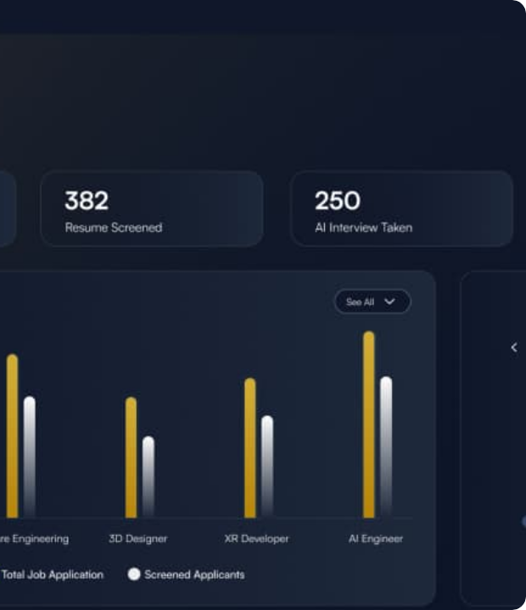
Mock Simulator Module
Real-Time Practice Engine
Features a 120-second dynamic countdown timer per question, a live voice recording interface, and an interactive question navigator.
Supports HR Behavioral (STAR method) and Core Technical tracks to build muscle memory under authentic time limits.

Slide 8
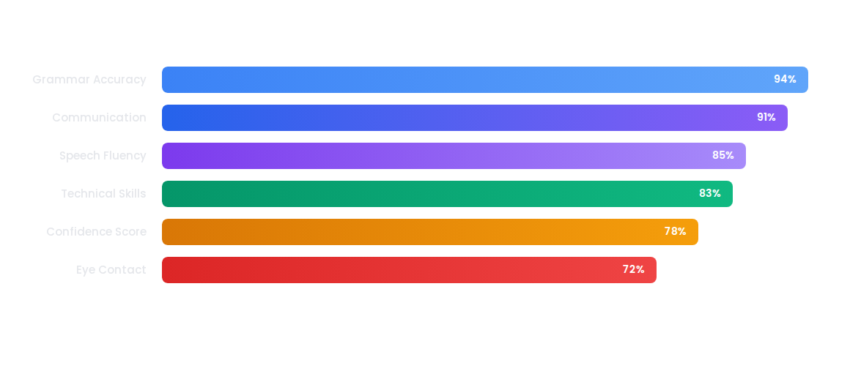
Feedback & Skill Evaluation
Performance Metric Sample: Multi-dimensional evaluation across communication clarity, structure, and candidate confidence.

Slide 9

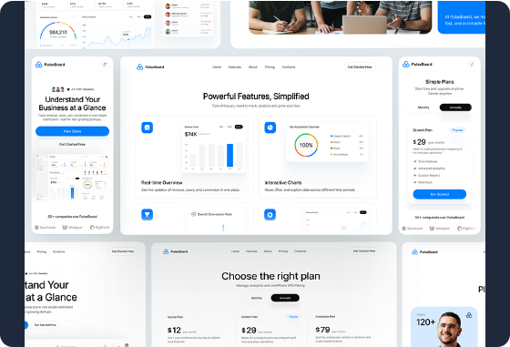
Analytics & Dashboard
✓
Real-Time Score Rings: Dynamic visual indicators displaying individual session and cumulative overall scores.
✓
Skill Progress Breakdown: Tracks linear metrics across communication, confidence, grammar, and fluency.
✓
Activity Feed: Logs past interview history, completed sessions, and recent performance updates.
✓
Actionable Tips: Provides personalized prompt cards to eliminate filler words and apply STAR framework.

Slide 10

Candidate Impact Metrics
Quantifiable Growth
Through structured practice sessions, candidates demonstrate a 12% increase in interview completion rate and a 5% average score improvement per month. Daily streaks keep students consistently engaged prior to placement drives.
Overall Completion Score

Slide 11
Gamification & Badges
Practice Streaks
Achievement System
Certificates
Tracks consecutive practice days (e.g., 9-day streak) to build muscle memory and articulate speech habits.
Unlocks milestone badges such as "First Steps", "7-Day Streak", and "Tech Pro" to keep candidates motivated.
Generates downloadable certificates (HR Interview Mastery, Technical Fundamentals) upon achieving target scores.

Slide 12

Tech Stack & MongoDB
✓
Frontend UI: HTML5, CSS3 Glassmorphism UI with native dark mode support, and Bootstrap 5 grid layout.
✓
Vanilla JavaScript Engine: Lightweight DOM manipulation, dynamic timer logic, and form validation.
✓
MongoDB Integration (Database): Implementing MongoDB for persistent storage of user profiles, session logs, scores, and certificates.
✓
Data Security & Auth: Storing hashed credentials, session tokens, and interview transcripts securely in MongoDB.

Slide 13
Development Roadmap
Phase 2 (Backend)
Phase 4 (Vision AI)
Node.js/Express REST APIs with MongoDB database for persistent user data & history.
WebRTC & OpenCV eye-contact detection and real-time emotion/confidence scoring.
Phase 1 (Current)
Phase 3 (AI Engine)
Frontend UI/UX prototype using simulated client-side scoring & interactive timer UI.
Integrating OpenAI GPT-4 for STAR evaluation & Whisper STT for live voice processing.

Slide 14
THANK YOU

